Slide 1

Probs & Stats
PRESENTATION
DIGITAL MARKETING
ANALYSIS
25 APRIL’24

Slide 2

Problem Statement
“Analyzing the Effectiveness of Digital Marketing Platforms in Driving Sales and Customer Reach: A Comparative Study of Instagram and Alternative Platforms.”
Social media platforms have become essential tools for boosting sales and return on investment in various industries in today's society. This presentation will explore how social media influences five important sectors: Entertainment, Travel and Hospitality, Food and Beverage and Education.
Statistical tests such as hypothesis testing, involving ANOVA, One Sample T-Testing and Paired Testing are used to identify significant differences and relationships between the variables of interest.

Slide 3
Project Goal
To examine how the industries use social media platforms for digital marketing are doing in terms of sales and customer engagement.
Using different statistical testings, we hope to analyse the statistical significance of changes in sales and consumer reach between Instagram and other platforms.
Scope of the project is to use engineering probability and statistics ideas to analyse, illustrate, and visualise customer engagement and sales between Instagram and other platforms.

Slide 4

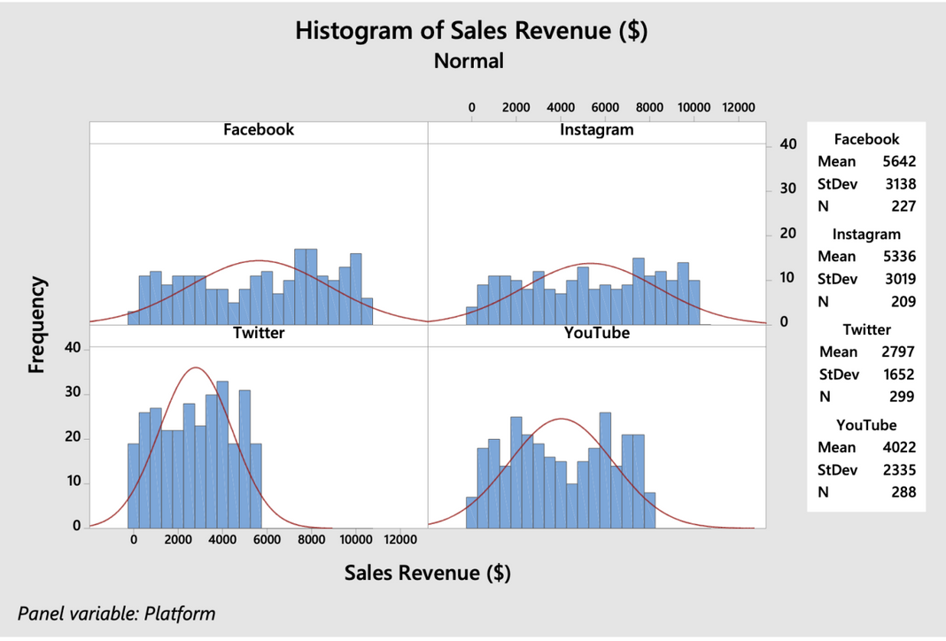
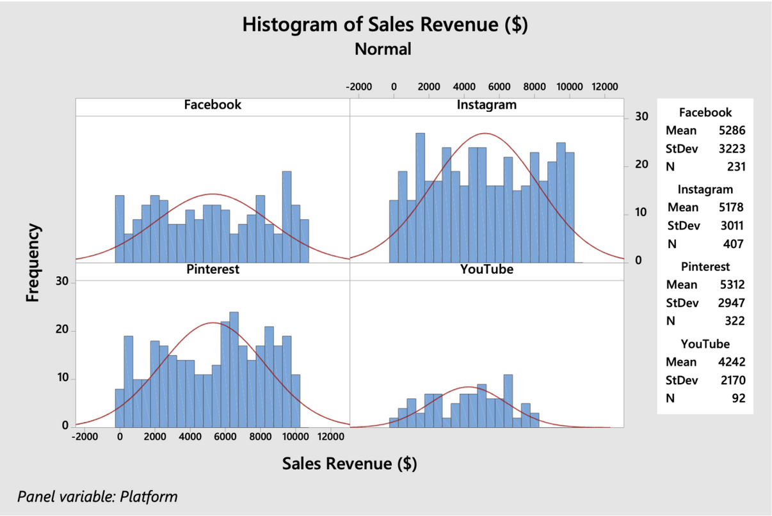
Entertainment Industry
FOOD AND BEVERAGE
Industry
Every platform exhibits distinct efficacy in generating sales revenue.
Pinterest generates higher sales revenue
Facebook mean value > Instagram mean value
X(Twitter) and YouTube generates low revenue

Slide 5
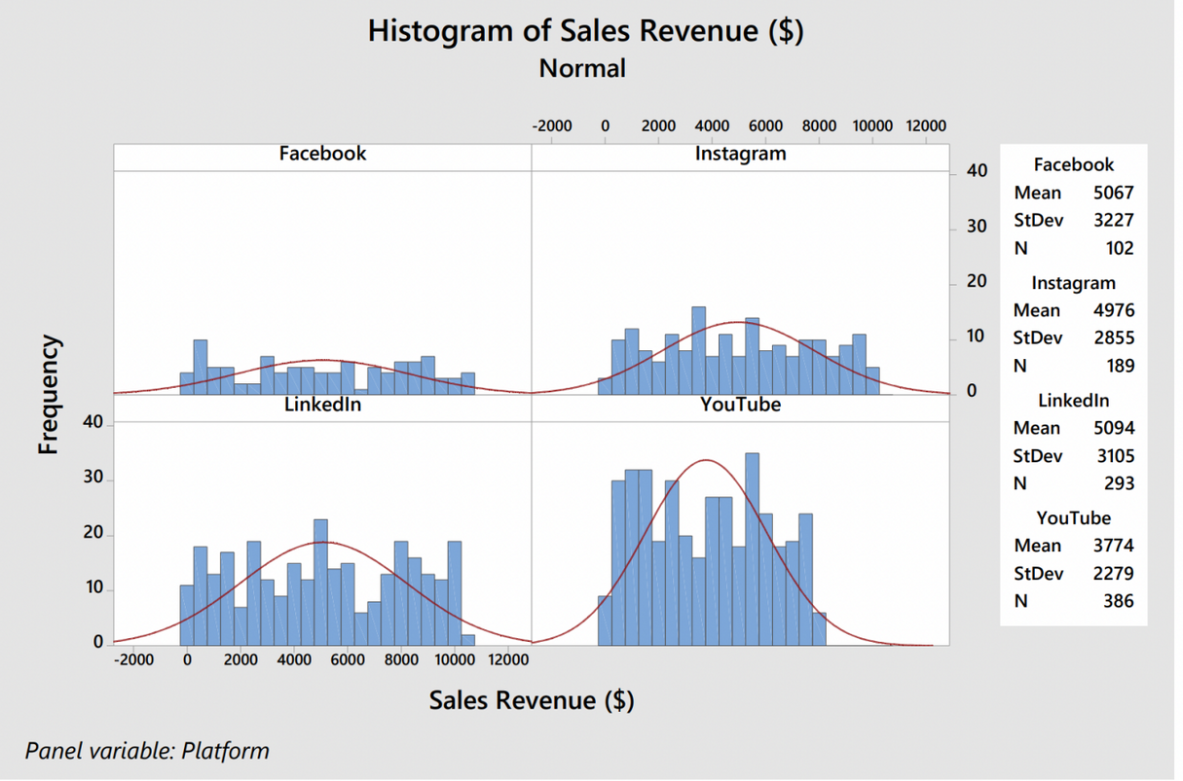
EDUCATION INDUSTRY
In the education sector, Facebook tops in sales revenue, followed by LinkedIn, while Instagram offers more stable returns than YouTube.
In Conclusion:
Facebook leads in revenue across entertainment, food, and education sectors, while other platforms like Instagram, Pinterest, and LinkedIn show strengths in specific industries.

Slide 6
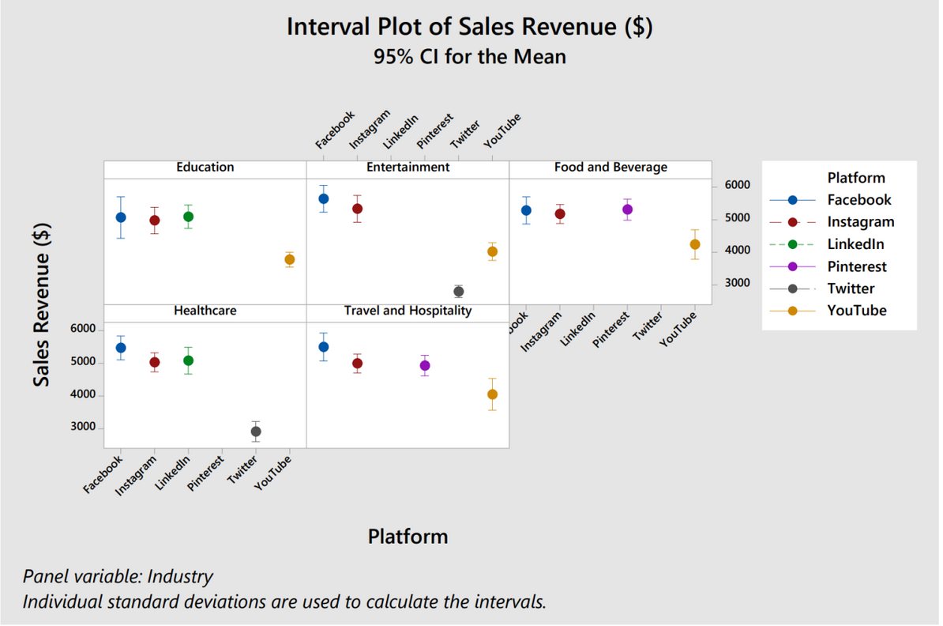
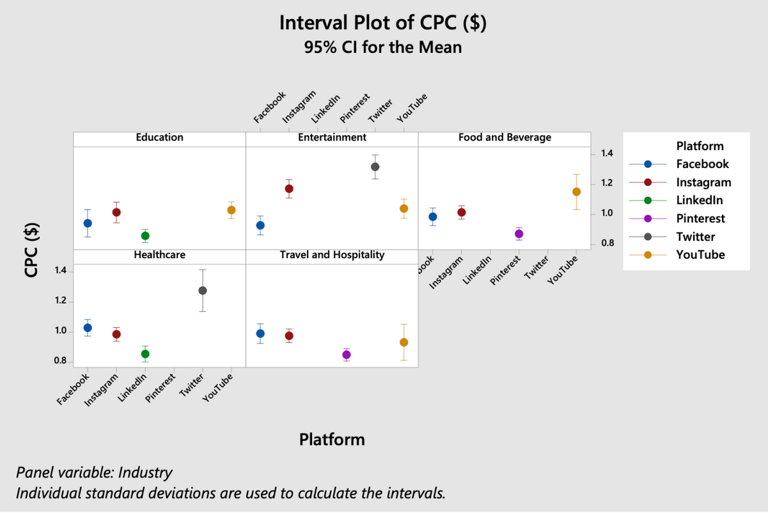
INTERVAL PLOT FOR SALES REVENUE
INTERVAL PLOT FOR cpc
Facebook and Instagram excel in visually-focused sectors.
LinkedIn's consistent performance across industries highlights the value of tailored marketing strategies for ROI optimization.
CPC trend is varying across different platform, strategic budgeting to improve ROI.

Slide 7
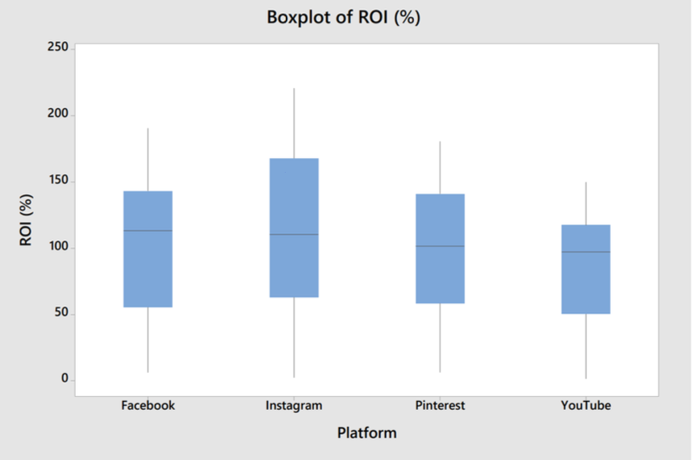
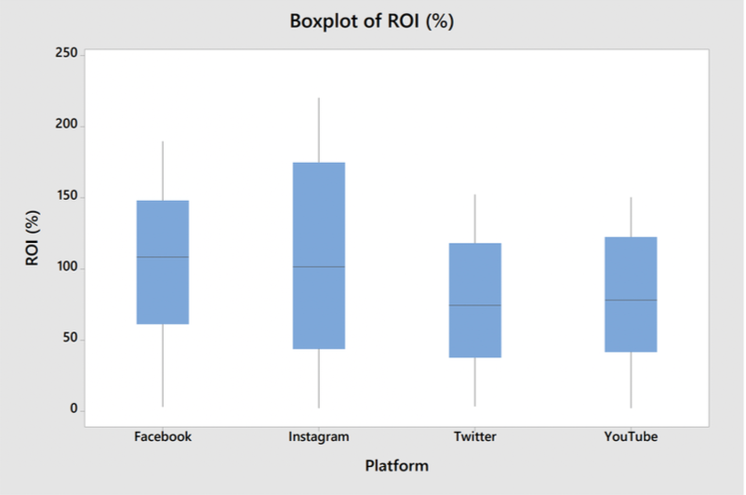
BOX PLOT FOR
TRAVEL
BOX PLOT FOR
entertainment
Customized travel tactics improve social media ROI by driving budget and content.
Facebook: highest median ROI.
Instagram and YouTube: More risk with higher return.
X(Twitter): Consistent ROI.

Slide 8
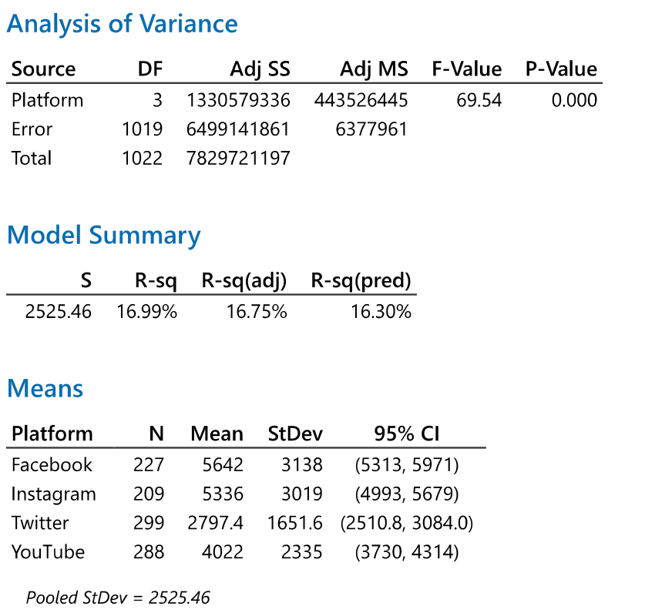
ANOVA ANALYSIS
Null hypothesis, Ho: Mean values are equal
Alternative hypothesis, Ha: Mean values are different
Significance level: α = 0.05
Rejecting null hypothesis, P-value
< 0.05.

Slide 9
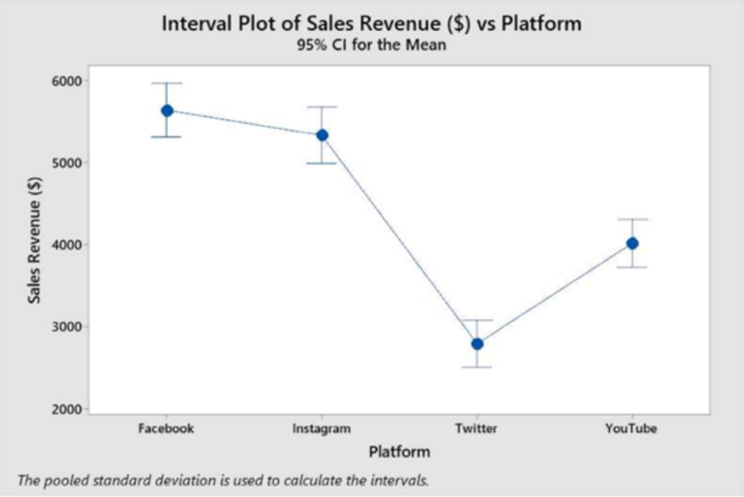
ANOVA ANALYSIS
Facebook and Instagram both show high average sales revenues in comparison with X(Twitter) and YouTube with lower mean sales revenues.

Slide 10
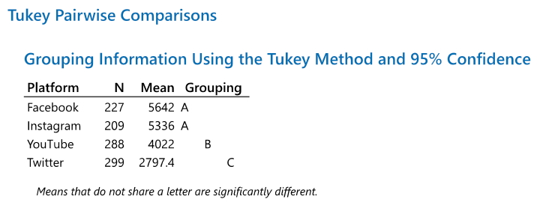
TUKEY PAIRWISE COMPARISONS
Group A = Facebook and Instagram, do not differ in sales revenue performance
Group B = YouTube intermediate performance with sales revenue.
Group C = X(Twitter), lower sales revenue.

Slide 11
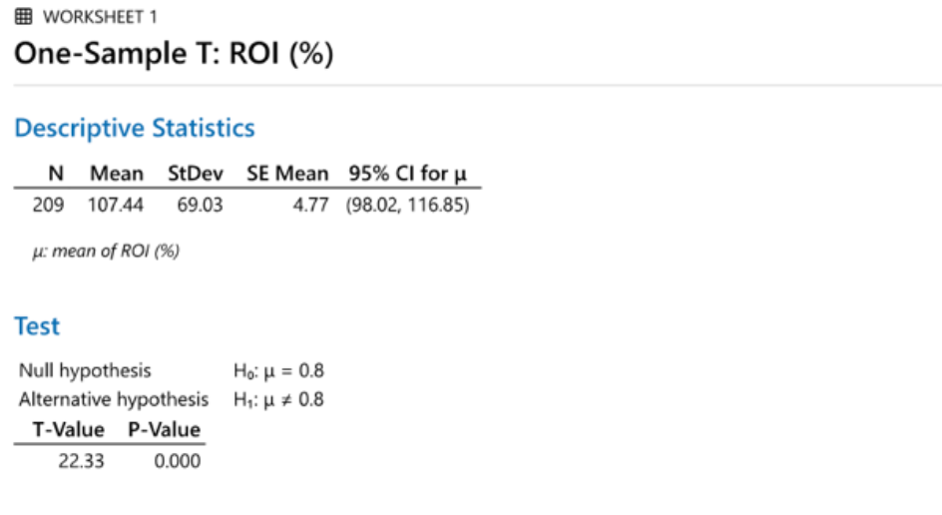
ONE SAMPLE T-TEST ANALYSIS
Data Points: 209
Mean ROI: 107.44%
Standard Deviation (SD): 69.03%
Standard Error of the Mean (SEM): 4.77
95% Confidence Interval (CI) for Mean ROI: 98.02% - 116.85%
T-value: 22.33
P-value: 0.000

Slide 12
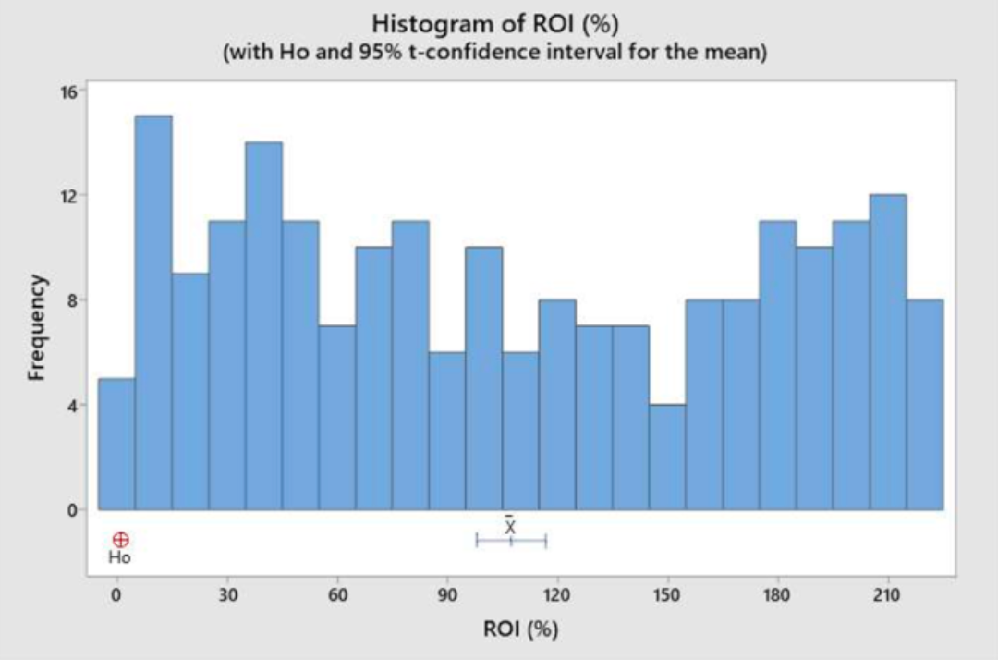
ONE SAMPLE T-TEST ANALYSIS
Conclusion:
This indicates a statistically significant difference between the sample mean ROI and the hypothesized value of 80%

Slide 13
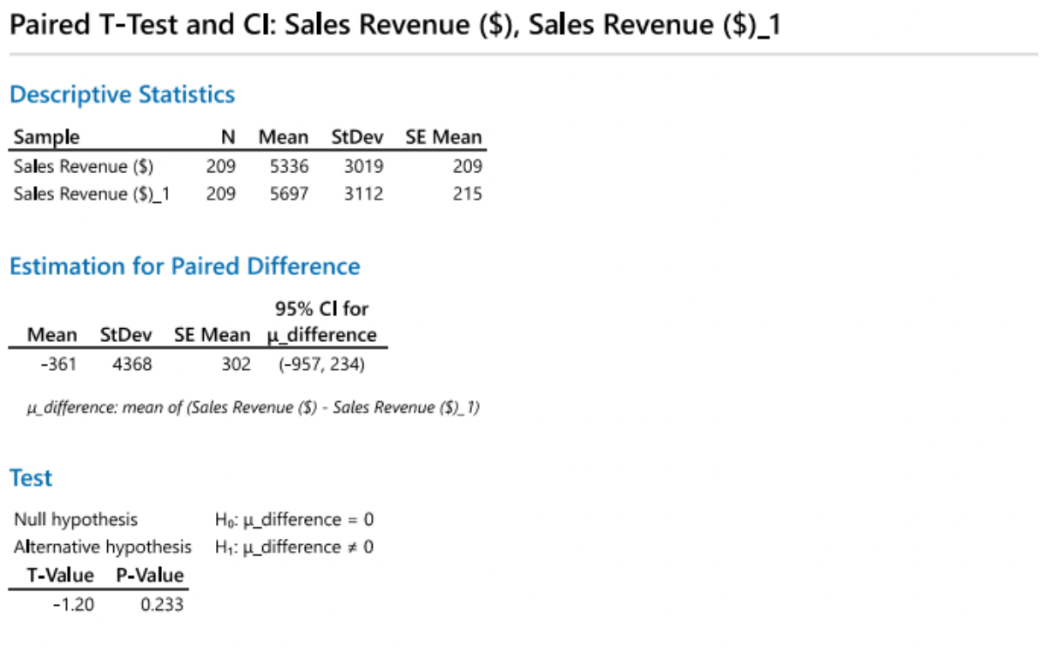
PAIRED TESTING
Slight average difference in sales revenue is identified between Instagram and Facebook with descriptive statistics.
Paired T-Test yields P-value - 0.233.

Slide 14
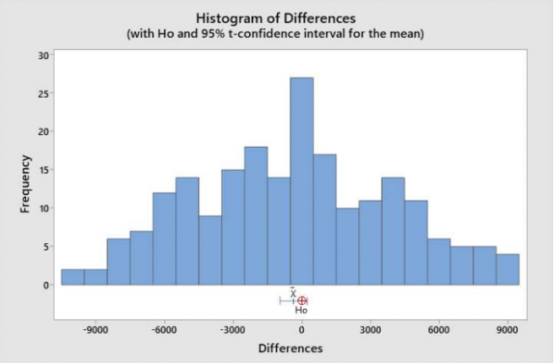
PAIRED TESTING
Paired T-test- Sales revenue potential for Instagram and Facebook in the entertainment industry.
so marketers can include them with confidence in digital marketing strategies that emphasize campaign details over revenue gaps.

Slide 15
LIMITATION
The possible biases or limits of the data source, which can impact how reliable the results are, are not discussed in the study.
Although the study concentrates on the examination of historical data, it does not offer any predicting insights that would be helpful for designing future marketing campaigns.
The study excludes qualitative analysis and individual brand strategy analysis, which could offer more context to the data.

Slide 16
CONCLUSION
We conclude that the impact of Instagram varies across different industries, and each sector exhibits a distinct response to various digital marketing platforms. While Instagram has shown considerable strength in some domains, it does not uniformly outperform other platforms in every industry.
This underscores the necessity for a strategic approach in selecting the most suitable platforms for marketing
Therefore, it's crucial for marketing strategies to be adaptive and industry-specific, recognizing the strengths of Instagram where applicable, while also capitalizing on the opportunities presented by other platforms to maximize reach and sales effectively.

Slide 17
PROPOSED NEXT STEP
Cross-Platform Interaction Effects:
Explore how the presence on one platform influences performance on another.
Investigate the synergy between multiple platforms in a single marketing strategy
Real-Time Data Analysis:
Implement a real-time data analysis component to provide more timely insights.
Utilize social media listening tools to gather and analyze data in real-time.

Slide 18

Thank you!

